Slide 1
Unit VIII
Using Animals and Human Subjects
in Research

Slide 2
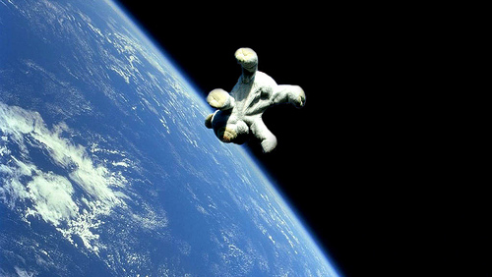
Part I Using Animals in Research

Slide 3
Using animals in research
Animals are often used in scientific research and applications for two main purposes
1. Non-experimental purpose:
refers to any action on animals for education or non-experimental purposes
for example, to dissect animals for educational purposes, to extract tissue and serum from animals to manufacture drugs
2. Experimental purpose:
refers to any action on animals to find out the solution of scientific or medical queries
for example, to let animal take drugs to test whether the drug is effective

Slide 4
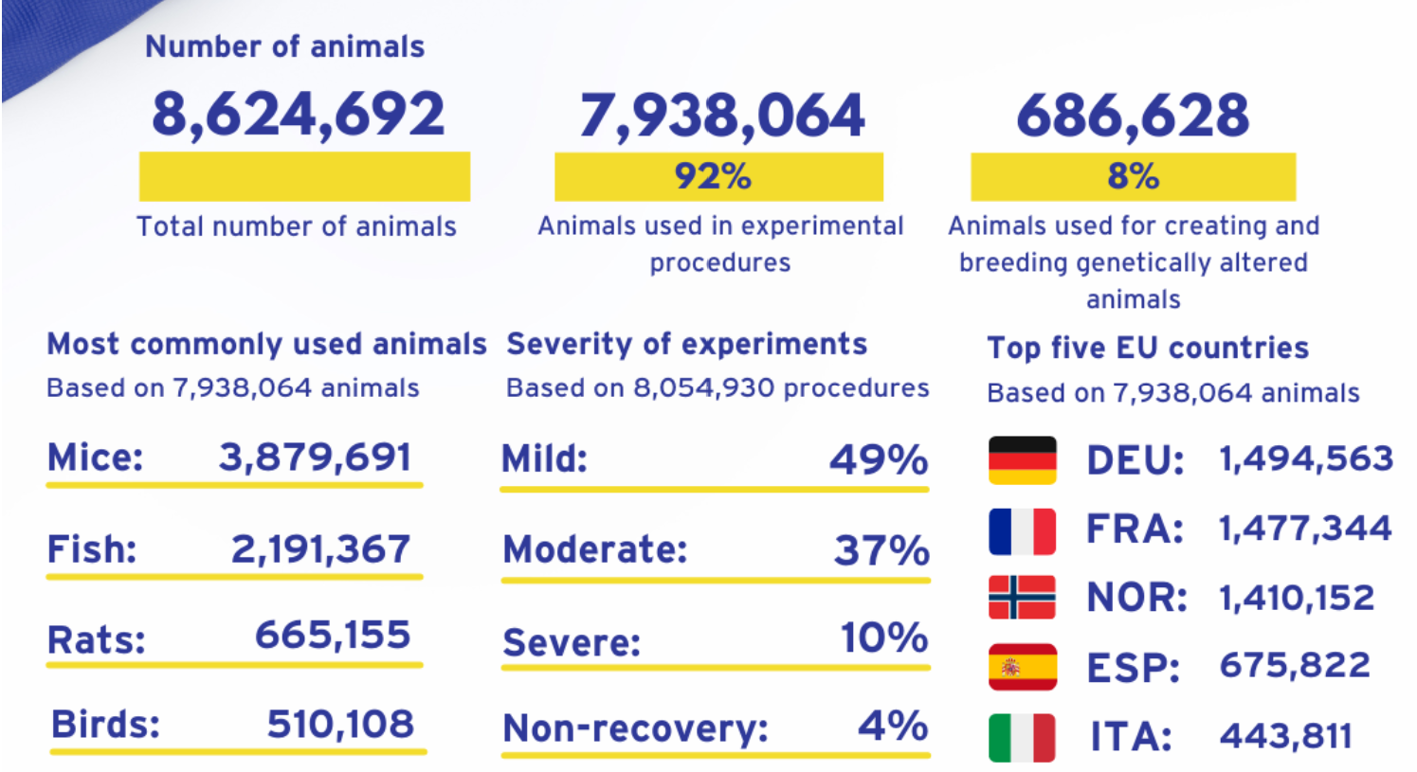
Animals used in scientific research in the EU in 2020 (not including the UK)
Note 1: The UK used about 1.38 M animals in research in 2020
Note 2: Cats, dogs, and primates (such as Monkeys) are species of particular public concern. Including horses in the UK, they can only be used when no other species are suitable
https://www.understandinganimalresearch.org.uk/news/eu-wide-animal-research-statistics-2020

Slide 5
Arguments for using animals in research
Using animals in research has been a topic of heat debate for a few decades
Advocates for animal testing say:
Human life has greater intrinsic value than animal life
Legislation has protected all lab animals from cruelty or mistreatment
Millions of animals are killed every year for food, is medical research not a more worthy death?
Few animals feel pain and most of them are killed before they suffer

Slide 6
Arguments for using animals in research
Opponents to animal testing say:
Animals have as much right to live as humans
Strict controls have not prevented some animals from being abused
Animals suffer while they are locked up and how do we know when they do and don’t feel pain
Deaths for research are unnecessary

Slide 7
3Rs to use animals in research
Scientists suggested three principles (3Rs) when using animals in research [1]. Become the guiding principles
Replacing, where possible, experiments using animals with alternative techniques such as cell culture, computer modeling or human volunteers instead of animals
Replace
Reduce
Refine
Refining the way the animals are cared for to help minimize any stress or pain, by using less invasive techniques where possible and improving medical care and living conditions
Reducing the number of animals used, by improving experimental techniques and sharing information with other researchers so that the same experiments aren’t being done by many people.
1. Russell, W. M. S. and Burch, R. L. (1959). “The Principles 0/ Humane Experimental Technique,” London: Methuen and Co. Ltd.

Slide 8
Using animals in teaching and research at PolyU
Anyone wanting to use animals in teaching or research in Hong Kong needs to apply for a license from the Department of Health of the Hong Kong Government under the Animals Control of Experiments Ordinance Cap 340
The license specifies the place(s) where experiments may be conducted, and special endorsements and permits are required for using animals:
for the purpose of attaining manual skills;
for the purpose of illustrating lectures;
without administering any anesthetic or killing the animal.
The code of ethics that the ordinance is based on also follows the 3R principles
After obtaining the license, an application should be made to the Animal Subjects Ethics Sub-Committee (ASESC) of PolyU for ethical review before the research can start

Slide 9
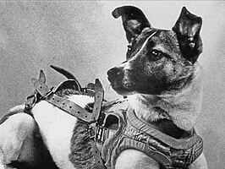
Case Study: Laika
Laika, a mixed-breed dog “recruited” into the Soviet space program after being found on the streets of Moscow in 1957
Laika’s mission would make her the first creature to orbit the Earth in an attempt to study the prolonged effect of weightlessness on a living being
https://en.wikipedia.org/wiki/Laika
https://www.ecolinc.vic.edu.au/sites/default/files/pages/Lesson_7_Ethics_of_Animal_Research_Power_Point_Presentation.ppt

Slide 10
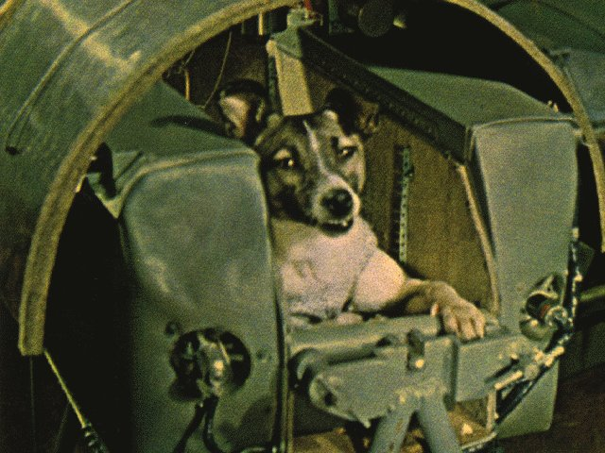
Background
Laika was 3 years old when she was launched on the Sputnik 2 spacecraft on November 3rd, 1957
She was secured in a special pressurized capsule 3 days before launch and provided with a high-nutrition gel for food and water
https://www.space.com/laika-space-dog
https://www.ecolinc.vic.edu.au/sites/default/files/pages/Lesson_7_Ethics_of_Animal_Research_Power_Point_Presentation.ppt

Slide 11
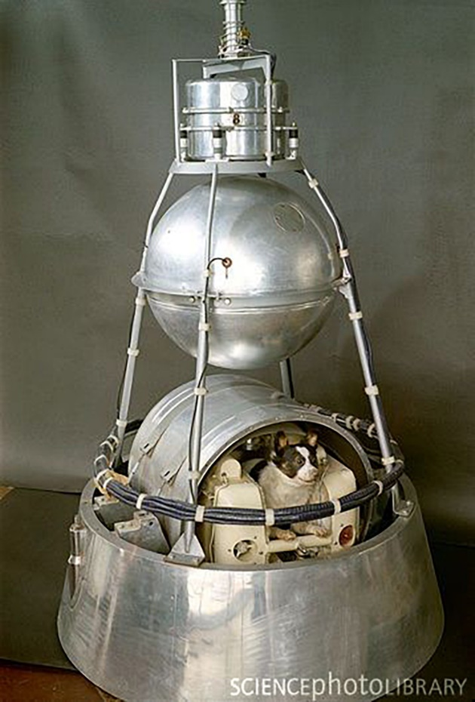
Background
Laika experienced minimal ill effects during launch but her heart rate did rise to three times its resting rate and she appeared to be quite agitated, eventually calming down
It appeared that weightlessness alone did not cause major changes to the vital physiological functions of a living creature
This was good news for human spaceflight
Mockup of Sputnik 2
https://www.nasa.gov/history/60-years-ago-the-first-animal-in-orbit/
https://www.ecolinc.vic.edu.au/sites/default/files/pages/Lesson_7_Ethics_of_Animal_Research_Power_Point_Presentation.ppt

Slide 12
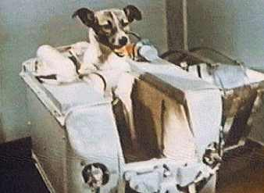
Background
Soon after launching, cabin temperature began rapidly climbing to unacceptably high levels
Temperature control inside the capsule was failing
Between 5 and 7 hours into the flight telemetry showed that there were no signs of life within the capsule
Laika had died from stress and overheating, undoubtedly a painful and distressing death
https://todayinsci.com/Events/Rockets/Laika.htm
https://www.ecolinc.vic.edu.au/sites/default/files/pages/Lesson_7_Ethics_of_Animal_Research_Power_Point_Presentation.ppt

Slide 13
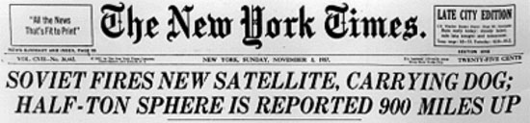
Background
As the world began to learn about the launch of Sputnik 2, no word of Laika’s death was released
The fact was that the Sputnik 2 capsule that carried Laika into orbit was not retrievable and it had been intended that Laika would die in orbit
But at the time the world believed that Laika might come back
https://www.ecolinc.vic.edu.au/sites/default/files/pages/Lesson_7_Ethics_of_Animal_Research_Power_Point_Presentation.ppt

Slide 14

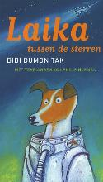
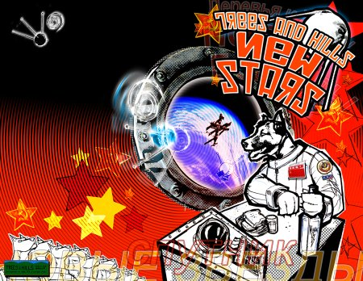
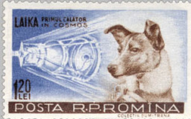
Background
Laika became a hero to the Soviet people and captured the imagination of the world
Her flight immediately proved the near-term capability for human spaceflight
On November 7th Soviet scientists were still claiming that Laika was in good health when she had in fact been dead for four days
Eventually the truth of the dog’s fate emerged and on November 11th the Soviets confirmed that Laika was dead
The exact cause of Laika’s death was not announced and remained a mystery for decades
https://www.ecolinc.vic.edu.au/sites/default/files/pages/Lesson_7_Ethics_of_Animal_Research_Power_Point_Presentation.ppt

Slide 15
Background
Protests from animal protection groups began around the world
The truth of how Laika died was finally uncovered in 2002 when Russian scientists confirmed that Laika had died between 5 and 7 hours after launch due to heat and stress
Russian scientist Oleg Gazenko who worked on the Soviet Space Program stated that “the more time passes, the more I’m sorry about it. We did not learn enough to justify the death of the dog.”
The question of whether the sacrifice of Laika was justified for the progress of space technology is still debatable nowadays in the context of the ethics of animal research
https://www.ecolinc.vic.edu.au/sites/default/files/pages/Lesson_7_Ethics_of_Animal_Research_Power_Point_Presentation.ppt

Slide 16
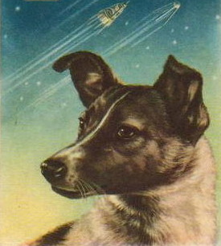
Debate
Arguments that support the mission
Laika was a wandering dog. She would have died due to starving anyway. Moscow is extremely cold in Winter
The experiment revealed how living creatures behaved in weightless conditions. It provided important information to later space missions with human being
The use of dogs was unavoidable as the tested subject needed to be close to human beings
Facilities were equipped to sustain Laika’s life as much as possible. The failure of the temperature control system was unexpected
https://www.ecolinc.vic.edu.au/sites/default/files/pages/Lesson_7_Ethics_of_Animal_Research_Power_Point_Presentation.ppt

Slide 17
Debate
Arguments against the mission
The experiment was designed to sacrifice Laika from day one. Laika was used just like a disposable tool. There was no respect at all to her life
When flying the first human to space, the orbit was designed to let the astronaut return to the Earth. Why the mission to fly the first dog to space was designed as a one-way journey?
Dogs are different from other animals such as mice or rats. They are close friends of human beings. They should be used with great care in research
There was no provision to reduce the pain of Laika before she died. Assume she did not die because of the malfunction of the temperature control system, her pain and stress would be even higher for wandering in space while starving or suffocating
https://www.ecolinc.vic.edu.au/sites/default/files/pages/Lesson_7_Ethics_of_Animal_Research_Power_Point_Presentation.ppt

Slide 18
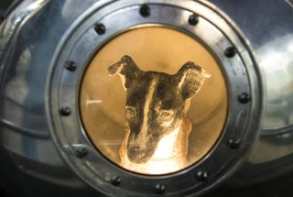
Discussion
Do you think that the space mission was justified for using a dog?
How could the experiment be improved?
Was the outcome of putting the first man in space a valid aim for sacrificing Laika?
Did the fact that the Soviet scientists covered up Laika’s death make the experiment more unethical?
Can the mission fulfill the 3R principles for using animals in research?
A model of Laika inside the Sputnik 2 capsule
https://www.space.com/laika-space-dog
https://www.ecolinc.vic.edu.au/sites/default/files/pages/Lesson_7_Ethics_of_Animal_Research_Power_Point_Presentation.ppt

Slide 19

Part II Using Human Subjects in Research
https://cdp.cancer.gov/resources/elsi/human_subjects_regulations_brochure.htm

Slide 20
Using human subjects in research
Advances in human health and welfare ultimately depend on research with human subjects
Properly designed and controlled studies with human subjects are essential to verify hypotheses about normal physiology, behavior, mechanisms of disease, processes of learning, or effectiveness of treatments, etc.
Unfortunately, not all human studies are justifiable and useful; human cruelty has sometimes been perpetrated in the name of research
Such as, the research made by the Japanese army on human subjects in China during the Second World War
Nuremberg Code (1949) - Main provisions:
The voluntary consent of the human subject is absolutely essential
Experiments with human subjects should occur only in the context of a clear scientific rationale

Slide 21
Belmont report
In the US, a federal commission was appointed in 70’s to identify fundamental principles that should govern human subject studies
The Belmont Report (1979) defined the ethical principles that now guide studies with human subjects in the US. They include
Respect for persons – individuals should be treated as autonomous agents; persons with diminished autonomy are entitled to protection
Beneficence – Two general rules (1) do not harm; and (2) maximize possible benefits and minimize possible harms
Justice – An injustice occurs when some benefit to which a person is entitled is denied without good reason or when some burden is imposed unduly

Slide 22
Human subject protection
Based on the Belmont Report, the U.S. National Institute of Environmental Health Sciences defined certain principles that must be followed when conducting research on human subjects [1]
Minimize harms and risks and maximize benefits
Respect human dignity, privacy, and autonomy
Take special precautions with vulnerable populations
Strive to distribute the benefits and burdens of research fairly
1. What is Ethics in Research & Why is it Important? U.S. National Institute of Environmental Health Sciences

Slide 23
PolyU regulation
It is a requirement of The Hong Kong Polytechnic University that all research/teaching projects involving human subjects must be reviewed for ethical appropriateness (ethics clearance)
Ensure that the benefits of the proposed research/teaching project outweigh the risks involved before permitting any experiment or study (including survey, interview, or questionnaire type of investigation) to proceed
Application should be sent to PolyU Institutional Review Board (IRB)
Non-clinical study – Send back to Department DRC for review
Clinical study – either review by 2 members of IRB (low-risk case) or a meeting with all members of IRB and the applicant (high-risk case)

Slide 24
FAQ – Is ethics clearance required …?
If I plan to visit some firms/companies to meet and talk to their CEOs on selected topics
No need if the discussion is not a part of a project.
If I plan to ask for students’ views on the quality of some audio samples
Yes, any interaction with human subjects as a part of a project requires ethics clearance
If I plan to study some archived data collected from human subjects by previous studies
No if only an audit of the archived data.
Yes if new and different data are to be generated from the archived samples.
If I plan to research human subjects in other countries
Yes, irrespective of the geographic locations of the human subjects
If I plan to conduct a project that has already got the ethics clearance
No if conducting the study according to the set protocol specified in the original research proposal approved by the Ethics Committee
Yes if a new research direction will be conducted without mentioning in the original proposal

Slide 25
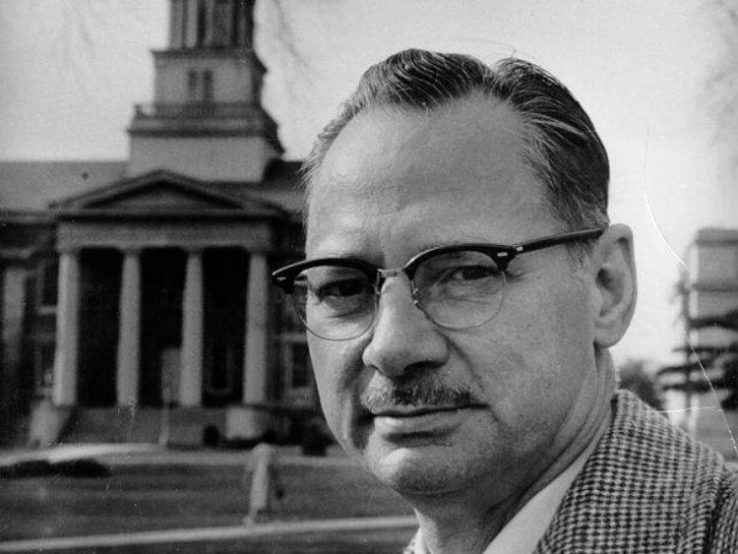
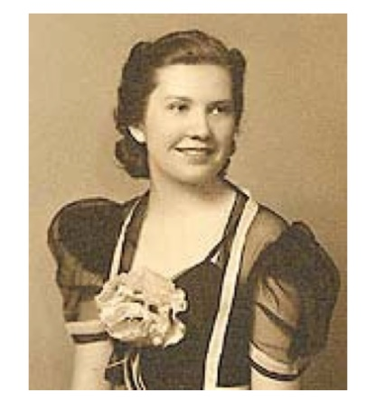
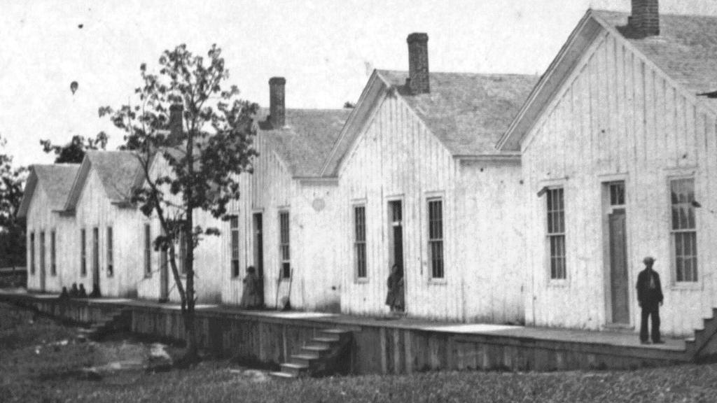
Case study – The Monster Study
The Monster Study was a stuttering experiment performed on 22 orphan children in Davenport, Iowa in 1939
Conducted by Dr. Wendell Johnson, a famous speech therapist, at the University of Iowa. Graduate student Mary Tudor conducted the experiment under Johnson's supervision
Dr. Wendell Johnson
Mary Tudor
Orphan Home in Iowa, US
https://cvltnation.com/the-monster-study-how-doctors-tortured-orphans-in-the-name-of-medicine/

Slide 26
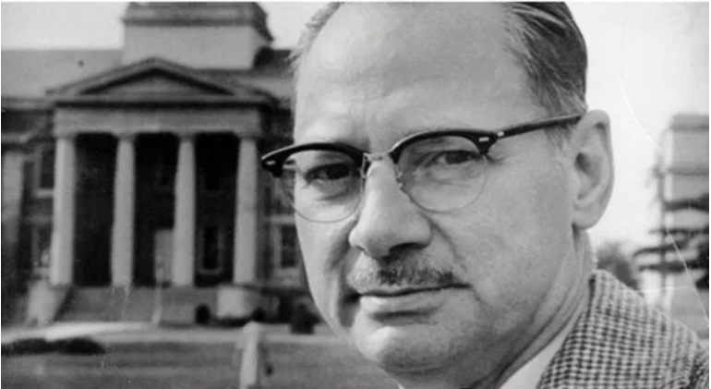
Background
CHILDHOOD
Dr Johnson was a stutterer. He however was speaking fine until he was around 5 or 6 years old. A teacher told his parents that he was beginning to stutter and he overheard. Johnson was subject to a host of different therapies to try and help cure his stutter. At the age of 16, his speech worsened significantly, and he asked to go to a stuttering school.
THINKING
He wanted to prove the theory that stuttering was caused by genetics, and that those who had a stutter were born with it was wrong. He was convinced that stuttering was a learned behavior.
Wendell Johnson
(April 16, 1906 – August 29, 1965) .
MARKING
‘’Begins not in the child's mouth but in the parent's ears.’ 'To prove his theory, he conducted an experiment which became known as the Monster Study.

Slide 27

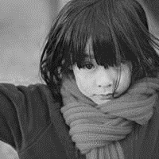
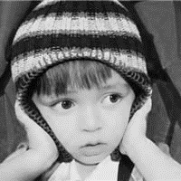

Methodology
22 orphans (5 to 15 years old) in an orphan Home in Iowa were chosen to participate in the experiment
None of the children were told the intention of the research. They were told to receive speech therapy
Johnson graduate student, Mary Tudor, talked with the children, each 45 min per few weeks. The experiment lasted for 5 months
STUTTER
NORMAL
5 STUTTERED
5 STUTTERED
6 NORMAL
6 NORMAL
5 were placed in Group IA and told that they did not stutter and that their speech was fine
The other 5 were placed in Group IB who were told that their speech was bad
6 of them were assigned to Group IIA who were told that their speech was not normal. They should do anything to avoid stuttering
The other 6 were placed in Group IIB and told that their speech was fine

Slide 28
Result
The results of the experiment did not give the conclusion Dr Johnson expected but introduced permanent harm to some children
Group IA
(5 children)
Stutterers were intentionally labeled as normal
1 did not change
2 improved fluency
2 decreased in fluency
Group IIA
(6 children)
Normal children were intentionally labeled as stutterers
2 did not change
2 decreased in fluency
2 improved fluency
No conclusion can be drawn if stuttering is a learned behavior

Slide 29
Consequence …
The nonstuttering children of Group IIA began to act like stutterers
''It was very difficult to get her to speak, although she spoke very freely the month before.''
''much more conscious of herself, and she talked less,''
''practically refuses to talk,''
“Because I'm afraid I can't say the next word.” “Why did you snap your fingers?” “Because I was afraid I was going to say ‘a.’”
''He stopped and told me he was going to have trouble on words before he said them,‘’
'''wouldn't come out. Feels like it's stuck in there.''
''Held hand or arm over eyes most of the time.''

Slide 30
Consequence
Some children suffered from this experiment
Became more reserved and were embarrassed to speak in front of people
Two originally nonstuttering children could not talk freely after the study and became stutterers for their whole lives
After the study, Tudor visited the group a few times and reported back to Dr. Johnson how they were doing. However, no positive speech therapy was provided to the suffering children

Slide 31
Consequence …
With World War II ended in 1945, the world was abhorred by the Nazi human subject experiments that came to light in the Nuremberg Trials
The details of the Monster study were covered up by the parties concerned to avoid possible challenges by the public
Dr. Johnson went on to become one of the most influential speech pathologists until his death in 1965
Only recently (2001) did San Jose’s Mercury News uncover the details of the experiment [1]
It introduced a multi-million dollar lawsuit to the University of Iowa, which later issued a formal apology on June 13, 2001, and called the experiment “regrettable”
[1] Dyer, Jim. "Ethic and Orphans: 'The Monster Study'". Mercury News. Archived from the original on 27 September 2011. Retrieved 19 September 2011.

Slide 32
Ethical concerns
The study was conducted well before the issue of the Nuremberg Code or Belmont Report
Academics were using human subjects freely at that time to conduct their experiments which they saw fit
Dr. Johnson was not the only team that used the orphans in that house in Iowa for doing human-related research
The experiment of the Monster Study might be seen as ethically all right at that time, but it will not be able to pass the standard nowadays
There are a few ethical concerns in this case that have been widely studied in recent years – which show that such kind of study should never be conducted nowadays

Slide 33
Ethical concerns
Dr. Johnson wanted to prove his theory that stuttering is a learned behavior when creating the Monster Study
Assume that Dr. Johnson truly believed in his theory
It implies that he intentionally induced stuttering in the normal children in the experiment
Besides, knowing harm was done to some normal children, Dr. Johnson did not conduct any correctional therapy for the suffering children
It violates the Belmont Report’s “Beneficence” principle
Beneficence – Two general rules (1) do not harm; and (2) maximize possible benefits and minimize possible harms
If Dr. Johnson was actually not so sure about his theory, it then violates the Nuremberg Codes
Experiments with human subjects should occur only in the context of a clear scientific rationale

Slide 34
Ethical concerns
Dr. Johnson chose children in an orphanage to conduct the experiment but without telling them the nature of the study
It violates the Nuremberg Codes
The voluntary consent of the human subject is absolutely essential
and also the Belmont Report’s “respect for persons” principle
Respect for persons – individuals should be treated as autonomous agents; persons with diminished autonomy are entitled to protection
Young children are not autonomous agents. Particularly, children in orphanages do not have parents, and thus cannot have proper guidance to make the decision to join the study or not, even if they know the nature of the study

Slide 35
What if the same study is conducted now?
If the same study is conducted nowadays, the researcher needs to do the following:
Seek ethical clearance from the related approval body on the appropriateness of the use of young children in the study
The researcher needs to provide strong scientific justification as to why using young children in the study is necessary and irreplaceable
Need to evaluate how much harm will be introduced to the participants and if the harm is reversible
The follow-up plan to reverse the harm to the participants
If the clearance is obtained, the researchers need to find a proper channel to recruit participants
Since the target is young children, the researchers need to seek the approval of their parents to let their children join the study
Details and objectives of the study should be released to the parents
In normal situations, the ethical clearance and the approvals of the parents will be very difficult to obtain as harm is expected to be exerted on the participants
In fact, the part of the experiment using normal children is not necessary, which is one of the major faults that many people commented on in the design of the Monster Study

Slide 36
Summary
Undoubtedly, using animals in research can improve the quality of human life
However, animals have their right to live. Thus, they should be used in research with great care
The guiding principles of using animals in research are Refining, Replacing, and Reducing
Advances in human health and welfare ultimately depend on research with human subjects
The guiding principles of using human subjects in research are Respect for persons, Beneficence, and Justice, as stated in the Belmont Report
Researchers who want to use animals in teaching or research should apply for a license from the Hong Kong Government
Before using animals or human subjects in a research project, ethical clearance should be obtained from the University

